Slide 1
INFORMATION TO COMMUNICATION AND TECHNOLOGY
Presentation
Presented To:
MAAM SAMAN SAFDAR :

Slide 2
Topic Name:
SUPER COMPUTERS

Slide 3
GROUP MEMBERS:
SYED MEHDI HAIDER FA21-BSE-010
DAWOOD IMRAN FA21-BSE-142
AOUN HAIDER FA21-BSE-133
SAMI ULLAH SHEIKH FA21-BSE-085

Slide 4
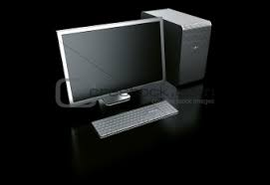
what Are computers ?
In past, commuters were generally invented to do basic operations e.g. addition , subtraction , multiplication , division.
Computer is invented by great scientist Charles Babbage.
The first personal computer was introduced in 1975 i.e. that is accessible to individuals.
Computers can store and process information , calculating algorithms.
In today’s era computers are a necessity of life.

Slide 5
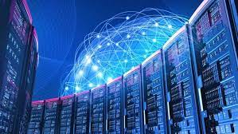
Super computers
The term super computer arose in the late 1920’s in the United States of California University.
As by name supercomputers are highly advanced in terms of simple computers.
They have great memory and speed.
These computers can alone used to do work of 64 computers.

Slide 6

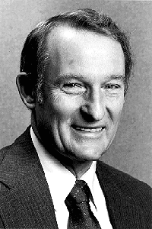
inventors:
There are many scientists who played an important role in the invention of supercomputers. Some of them are mentioned below:
“Boris Babayan” is a Russian scientist which is also known as the “Creator of Super Computers”. He also received a Lenin Prize in 1987.
The design manufacturer of first supercomputer is “Seymour Cray”.
July 8,1957 was a memorable date in the history of super computers.
BORIS BABAYAN
SEYMOUR CRAY

Slide 7

What and why was the need of supercomputer?
For testing complex mathematical models.
Physical phenomenon and design.
Climate and weather changes.
Fast processing speeds.
Extra and super sized storage capacities.

Slide 8
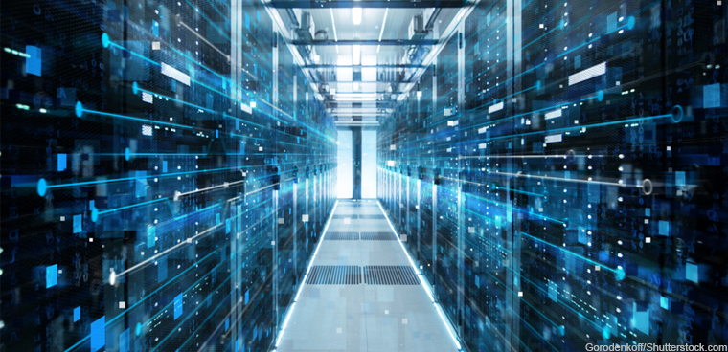
What makes a computer a supercomputer?
A super computer is a computer with a high level of performance as compared to a general-purpose computer. The performance of a super computer is commonly measured in floating point operations per second (FLOPS) instead of million instructions per second (MIPS).

Slide 9
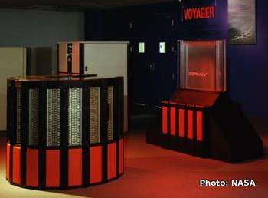
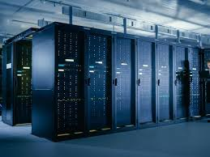
Types:
There are many types of supercomputers. Some of them are stated below:
Jaguar
Titan
Nebula
K Computer
Plelades
Kraken
Tianhe-1
IBM Sequoia
Jugene

Slide 10

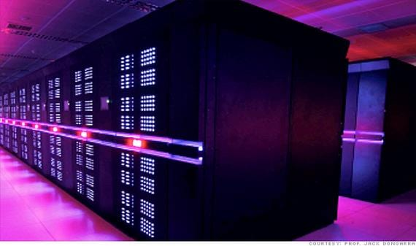
Tianhe-2(super computer):
China’s National University of Defence Technology TIANHE-2 super computer can perform over 33 quadrillion calculations per second (33.86 petaflops). To put that in perspective , the Tianhe-2 super computer can perform in one second about 3 million calculations for every person on the planet.
Isn’t it that amazing!
CHINA’s TIANHE-2 SUPER COMUTER

Slide 11
Characteristics:
They can support more than a hundred users at a time.
This machine is also faster than the imagination of humans.
These computers are capable of doing all kinds of work.
Many people can work at the same time on a supercomputer.
These are the most expensive computers and can be made anytime.
Supercomputers have huge storage capacities.
Minimum 4000-8000 ordinary computers can be combined to form a supercomputer.

Slide 12
Features:
They have more than 1 CPU (Central Processing Unit) which has instructions so that it can interpret instructions and perform arithmetic and logic tasks.
The supercomputers can support extremely high computation speed of CPU’s.
Super computers having more than one CPU are very fast and very easily able to perform arithematic and logic tasks.
They are highly used in following :
National security
Nuclear weapon designs
Cryptography
Aerospace
Automotive
Petroleum industries
Space stations
And many more places

Slide 13
Uses of super computers:
Super computers are used in following aspects of life:
Film Making
Military and Defence
Weather Department
Scientific Research Departments
Store Database
Smog Control System
Play Game
Data Encrypt and Mining

Slide 14
Uses of supercomputers:
Today super computers are used in film industry for imaginary computerized scenes in films.
Super computers are used to conduct virtual tests of nuclear explosions and weapon ballistics.
Weather is predicted by Super computers .
In large organizations such as ISRO and NASA , Super computers are used.
Websites like Google, Bing, Web Hosting providers , these all are using Super computers today.
Super computers are being used to play visual and graphic games.
Super computers super computers are also used for encrypting data and mining the data.

Slide 15

Is it easy to buy a super computer?

Slide 16
Rates and prices of super computer:
Supercomputers are very expensive. Some of world top supercomputer rates are:
The Jaguar supercomputer price 104 million US Dollar.
Titan supercomputer price is 90 million US dollars.
The Roadrunner supercomputer price is 100 million US Dollar.
Fugaku supercomputer price is 1 billion US dollars (total programme cost).

Slide 17
Why does really need that?
We have computers working in our station, schools , hospitals etc.
Think and observe?

Slide 18
Advantages of super computer:
Supercomputers have more than one CPU and ten thousand processors.
A supercomputer can decode any password because the speed of the supercomputer is very fast, so it finds the password immediately.
Today big companies are using supercomputers because other computers take ten to fifteen days to do any work, same supercomputer takes one to two days to do their work, which saves both time and money.
Supercomputers can run many types of operating systems.

Slide 19
Disadvantages:
A supercomputer needs a lot of electricity to run.
To install a supercomputer, a lot of land is required.
Approximately 500 or 550 square land required to install a supercomputer it occurs.
A supercomputer has a lot of processors due to which the supercomputer heats up very quickly.
Supercomputers are so expensive that no ordinary person can afford it.

Slide 20

Doesn’t it means our information is in wrong hands?

Slide 21
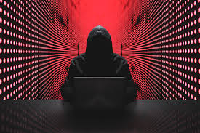
Is it easy to hack a super computer?
ANSWER:
No , it is not that easy. But possible in a manner.
Basically super computers consists of large organizations of computers. Moreover to crack or hack them we need a large and combined network of humans with computers equipments ,softwares and one satellite connections .
HEADLINE:
In covid-19, hackers target supercomputers researching on covid vaccines in SWITZERLAND , GERMANY , UK.

Slide 22

How to prevent data from hacking?
There are some steps for you to save your data :
If there is hacker who enters in your data your computer will tell you.
Firstly in this case, you need to be offline so that your data migration would be stopped.
Second you need to shut down your computer. This will sometimes cause your current data to lose and save your overall data.

Slide 23
THANK YOU

